Slide 1
Credit risk assessment case study 1
Siva

Slide 2
Abstract
Reference:
“Credit Risk Analysis and Prediction Modelling of Bank Loans Using R”
By Sudhamathy G., International journal of Engineering and technology, Vol 8 No 5 Oct-Nov 2016.
Nowadays there are many risks related to bank loans, especially for the banks so as to reduce their capital loss. The analysis of risks and assessment of default becomes crucial thereafter.
Banks hold huge volumes of customer behaviour related data from which they are unable to arrive at a judgement if an applicant can be defaulter or not.
Data Mining is a promising area of data analysis which aims to extract useful knowledge from tremendous amount of complex data sets.
In this paper we aim to design a model and prototype the same using a data set available in the UCI repository.
The model is a decision tree based classification model that uses the functions available in the R Package.
Prior to building the model, the dataset is pre-processed, reduced and made ready to provide efficient predictions.
The final model is used for prediction with the test dataset and the experimental results prove the efficiency of the built model.

Slide 3
Data set
in this paper, a data mining framework for PD estimation from a given set of data using the data mining techniques available in R Package is presented.
The data used to implement and test this model is taken from the UCI Repository.
The German credit scoring dataset with 1000 records and 21 attributes is used for this purpose.
The numeric format of the data is loaded into the R Software and a set of data preparation steps are executed before the same is used to build the classification model.
Package used DMwR.

Slide 4
Data set and the process
The package unable to install in R studio but gets installed in the R prompt.
Data is to be downloaded from
https://archive.ics.uci.edu/ml/datasets/statlog+(german+credit+data)
Data used “German.data-numeric
The present data differed from what is used in the paper.
May be the first 20 columns as the data and 21st column as the results(output classes – binary – whether credit worthy or not.

Slide 5
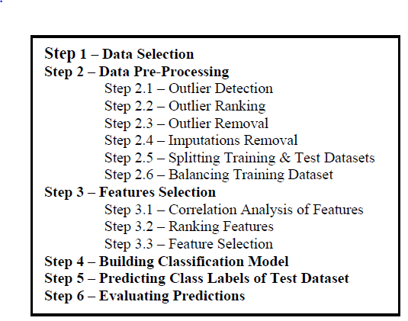
Stages

Slide 6
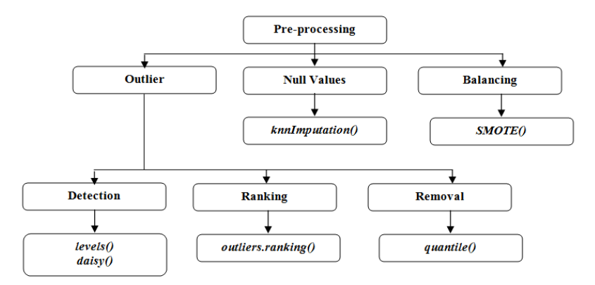
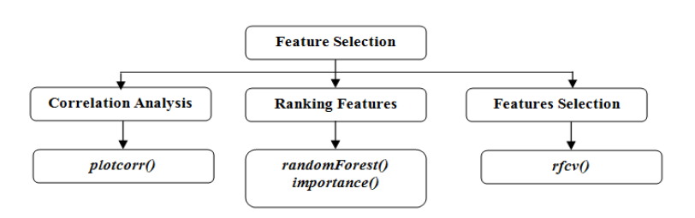
Substeps

Slide 7
Data set attributes
The numeric data set downloaded is slightly different from the original data set.
However in general the attributes taken into account are
Status of Existing Account
(1: < 0 DM, 2: < 200 DM, 3: >= 200 DM, 4: No existing Account)
A2: Loan Duration in Month
A3: Credit History
(0: No credits taken so far, 1: All credit in this Bank paid back duly,
2: Existing credits paid back dully till now,
3: Delay in paying off in the past,
4: Credits existing in other banks)
A4: Loan Purpose
(0: new car purchase, 1: used car purchase,
2: furniture or equipment purchase, 3: radio or television purchase,
4: domestic appliances purchase,
5: repairs, 6: education, 7: vacation, 8: retraining,
9: Business, 10: others)

Slide 8
A5: Credit Amount (in DM)
A6: Bonds / Savings
(1: < 100 DM, 2: >= 100 and < 500 DM, 3: >= 500 DM and 1000 DM,
4: >= 1000 DM, 5: no savings / bonds)
A7: Present Employment Since
(1: unemployed, 2: < 1 year, 3: >= 1 and < 4 years,
4: >= 4 and < 7 years, 5: >= 7 years)
A8: Instalment rate in percentage of disposable income
A9: Personal Status and Sex
(1: Divorced Male, 2: Divorced/Married Female, 3: Male Single,
4: Married Male, 5: Female Single)
A10: Other Debtors / Guarantors
(1: None, 2: Co-applicant, 3; Guarantor)

Slide 9
A11: Present Residence Since (in Years)
A12: Property
(1: Real Estate, 2: Life Insurance, 3: Car or others, 4: No property)
A13: Age in years
A14: Other instalment plans
(1: Bank, 2: Stores, 3: None)
A15: Housing
(1: Rented, 2: Owned, 3: For Free)
A16: Number of existing credits at this bank
A17: Job Status
(1: Unemployed non-resident, 2: Unemployed resident,
3: Skilled Employee, 4: Self-Employed )
A18: Number of People being liable to provide maintenance for
A19: Telephone
(0: Not Available, 1: Available)
A20: Foreign Worker
(0: No, 1: Yes)
Def: Class Label
(0: Non Default, 1: Default)

Slide 10
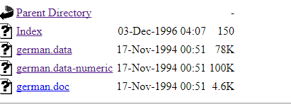
Preparation
The data set to be downloaded from https://archive.ics.uci.edu/ml/machine-learning-databases/statlog/german/
german.data-numeric is the one selected.
Last 4 columns are removed
The first row to be headers. (A1, A2 etc., ) The last column to be named as “Def”
May be, the last column(25 can be used as output(1 or 2.) Also 1 and 2 can be replaced by 0 and 1.

Slide 11
Notes
Normalization: Based on division by range.
Select the numeric data and perform Normalization.(check the paper)
Outliers ranking
The agglomerative hierarchical clustering algorithm chosen for ranking the outliers is less complex and easy to understand. Each observation is assumed to be a cluster and in each step, the observations are grouped based on the distance between them. Each observation that is observed later has lower rank. It is seen that the observations with lower rank are outliers because there are dissimilarities between them and the other observations.
Based on the type of the data element they ar eto be specified.
distance=daisy(creditdata[,-19],stand=TRUE,metric=c("gower"), type = list(interval=c(2,5,8,11,13,16,18), nominal = c(1,3,4,6,7,9,10,12,14,15,17), binary=c(19,20)))
Imputations removal: There are no Null values. Hence no need for imputation.

Slide 12
Stages
Splitting: Sample function in DMwR
Balancing training data set is required since the output classes are in 70:30 ratio.
Hence K means algorithm has been used to take some more samples for the class for which data is lacking.
Note: that part of the data has not been used in this case.
Features selection:
(https://chrisalbon.com/machine-learning/feature_selection_using_random_forest.html)
Correlation analysis:library(package="ellipse")
Done for each data type.
c= c(2,5,8,11,13,16,18)
plotcorr(cor(creditdata_noout_noimp_train[,c]),col=cl<-c(7,6,3))

Slide 13
Ranking features, rpart constructs the tree
RandomForest algorithm s used to rank the importance of the features .
importance(randf, type=1, scale=TRUE) and varImpPlot(randf)
It is presented in the values under the name “mean decrease accuracy”.
Model building:
library(rpart)
c = c(4, 8, 11, 15, 17, 18, 22) # c( ?????????????)
trdata=data.frame(creditdata_noout_noimp_train[,-c])
tree=rpart(trdata$Def~.,data=trdata,method="class")
printcp(tree)

